Slide 1
RATE LIMITER THROTTLING LOAD SHEDDING
SYSTEM DESIGN
@codefarm
#systemdesign
SOFTWARE ARCHITECTURE

Slide 2
Scaling From Zero To Billions Of Requests
SYSTEM DESIGN
#codefarm
#SystemDesign
SOFTWARE ARCHITECTURE

Slide 3
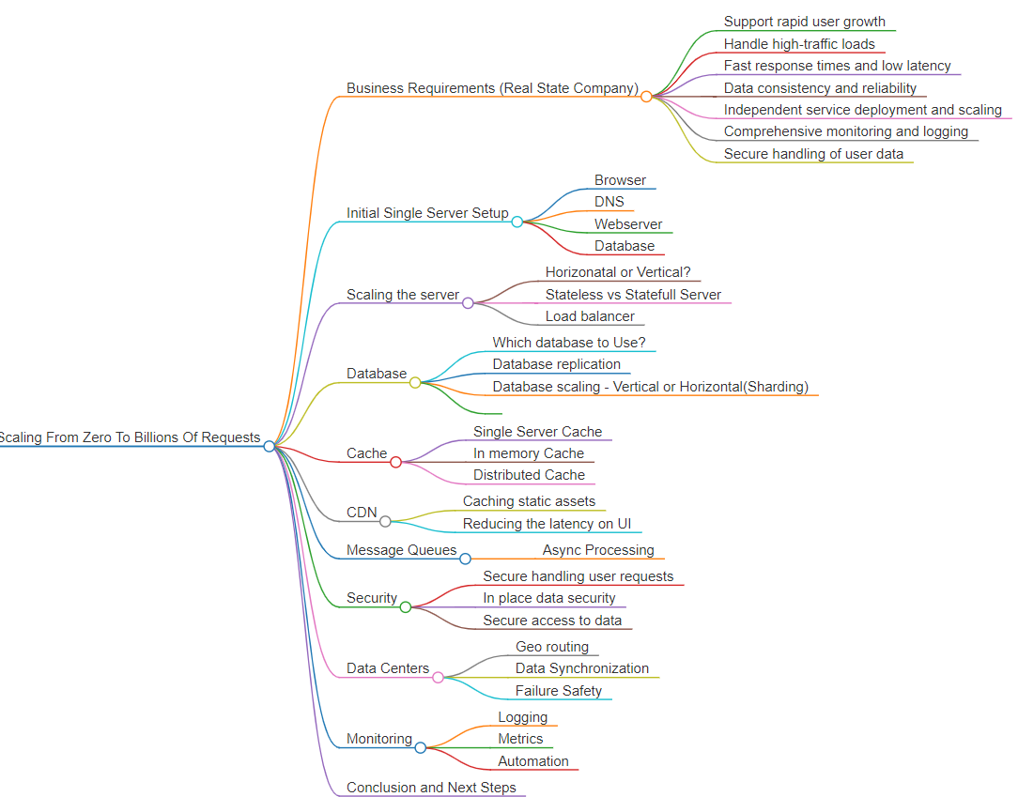
SYSTEM DESIGN
Scaling From Zero To Billions Of Requests
#codefarm
#SystemDesign
SOFTWARE ARCHITECTURE

Slide 4
SYSTEM DESIGN
#1
Single server setup
Scaling From Zero To Billions Of Requests
#codefarm
#SystemDesign
SOFTWARE ARCHITECTURE

Slide 5
SYSTEM DESIGN
#2
Scaling the server horizontal vs vertical stateful vs stateless
Load balancer & API Gateway
Scaling From Zero To Billions Of Requests
#codefarm
#SystemDesign
SOFTWARE ARCHITECTURE

Slide 6
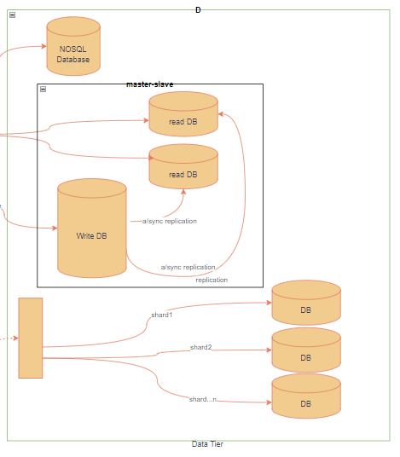
SYSTEM DESIGN
#3
database sql vs nosql
Replication
sharding
Scaling From Zero To Billions Of Requests
#codefarm
#SystemDesign
SOFTWARE ARCHITECTURE

Slide 7
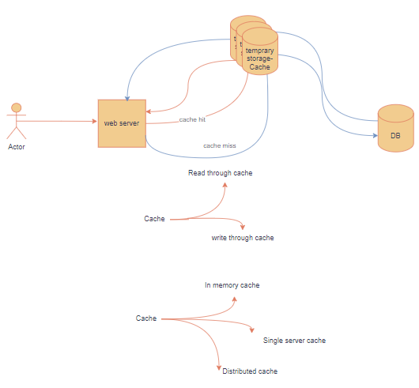
SYSTEM DESIGN
#4
cache Single Server Cache
In memory Cache
Distributed Cache
Scaling From Zero To Billions Of Requests
#codefarm
#SystemDesign
SOFTWARE ARCHITECTURE

Slide 8
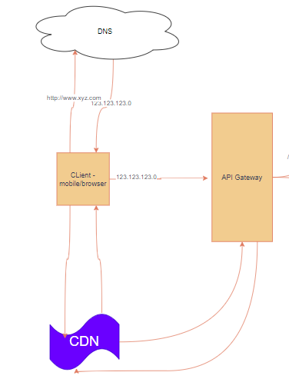
SYSTEM DESIGN
#5
CDN Caching static assets
Reducing the latency on UI
Scaling From Zero To Billions Of Requests
#codefarm
#SystemDesign
SOFTWARE ARCHITECTURE

Slide 9
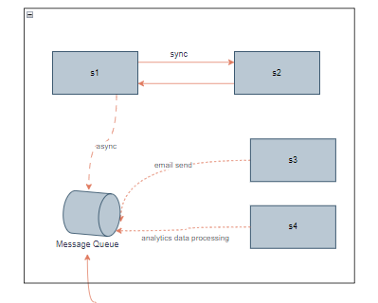
SYSTEM DESIGN
#6
Message queues Async communication
Scaling From Zero To Billions Of Requests
#codefarm
#SystemDesign
SOFTWARE ARCHITECTURE

Slide 10
SYSTEM DESIGN
#7
Security in
architecture
Scaling From Zero To Billions Of Requests
#codefarm
#SystemDesign
SOFTWARE ARCHITECTURE

Slide 11
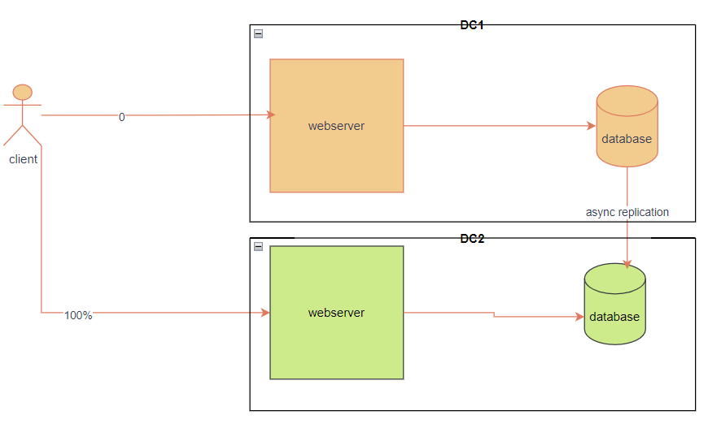
SYSTEM DESIGN
#8
Data Centers
Geo routing
Data Synchronization
Failure Safety
Scaling From Zero To Billions Of Requests
#codefarm
#SystemDesign
SOFTWARE ARCHITECTURE

Slide 12
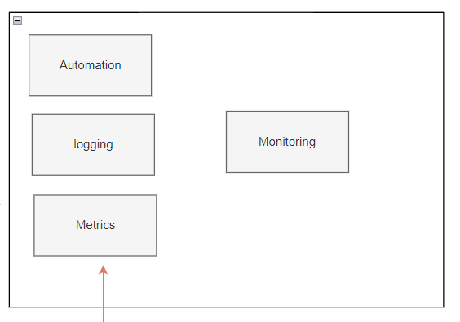
SYSTEM DESIGN
#9
Monitoring
Automation
Logging
Metrics
Scaling From Zero To Billions Of Requests
#codefarm
#SystemDesign
SOFTWARE ARCHITECTURE

Slide 13
SYSTEM DESIGN
#10
COnclusion
Scaling From Zero To Billions Of Requests
#codefarm
#SystemDesign
SOFTWARE ARCHITECTURE

Slide 14
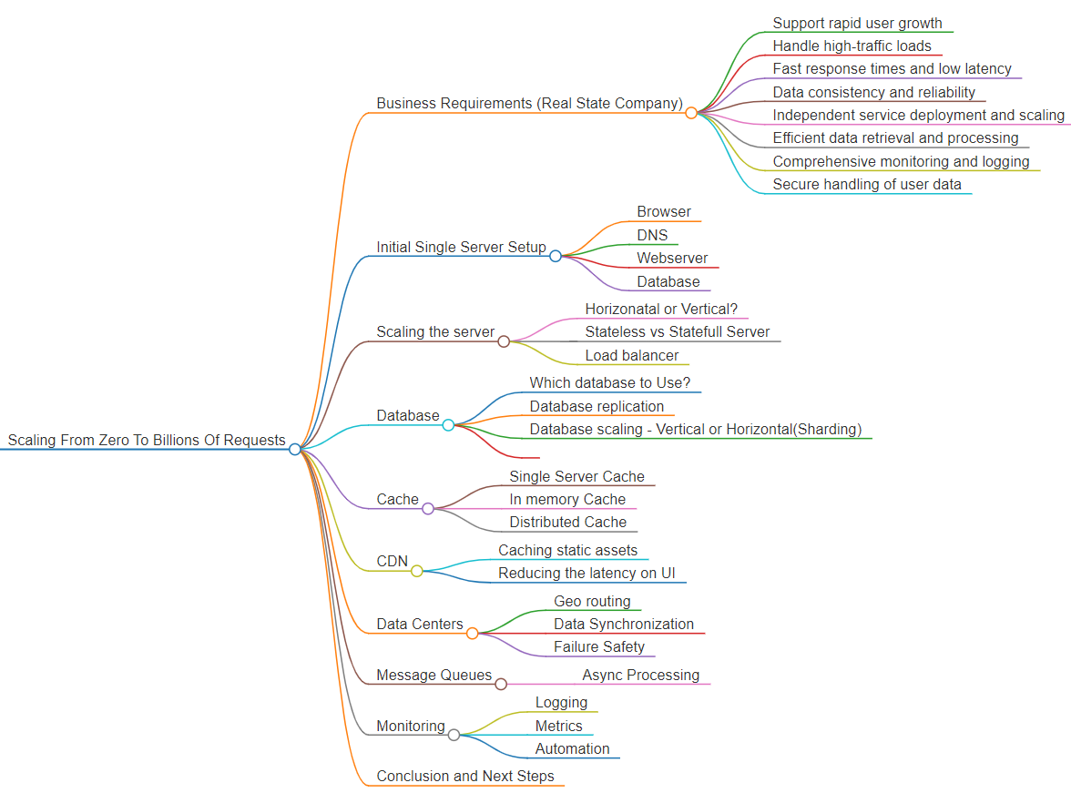

Slide 15
Unique id generator in distributed system
SYSTEM DESIGN
#codefarm
#SystemDesign
SOFTWARE ARCHITECTURE

Slide 16
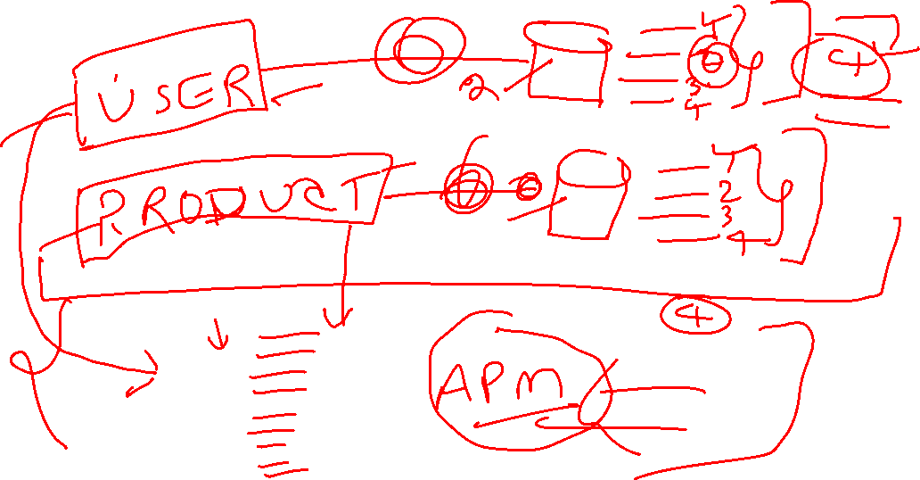
Problem Statement

Slide 17
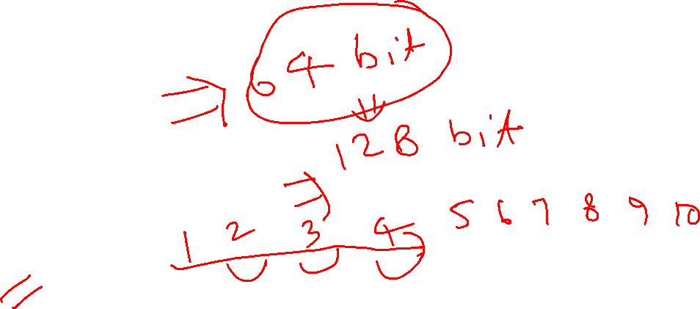
Requirements
Uniqueness
Numerical Values
Space optimized
Time ordered
Fit for distributed systems
Low Latency
Security

Slide 18
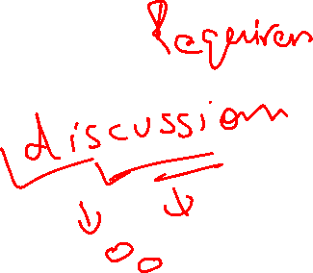
Available Options
Database Auto Increment
UUID
Central Server
Snowflake

Slide 19
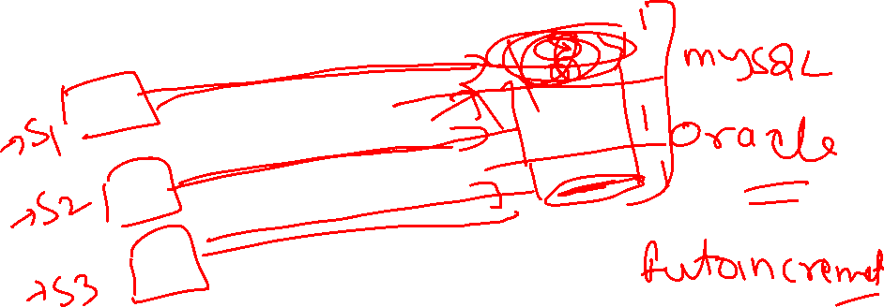
Database Auto Increment

Slide 20
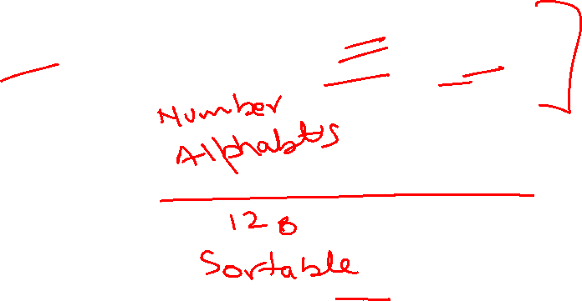
UUID
Universally Unique Identifiers, or UUIDS, are 128 bit numbers,
Composed of 16 octets and represented as 32 base-16 characters

Slide 21
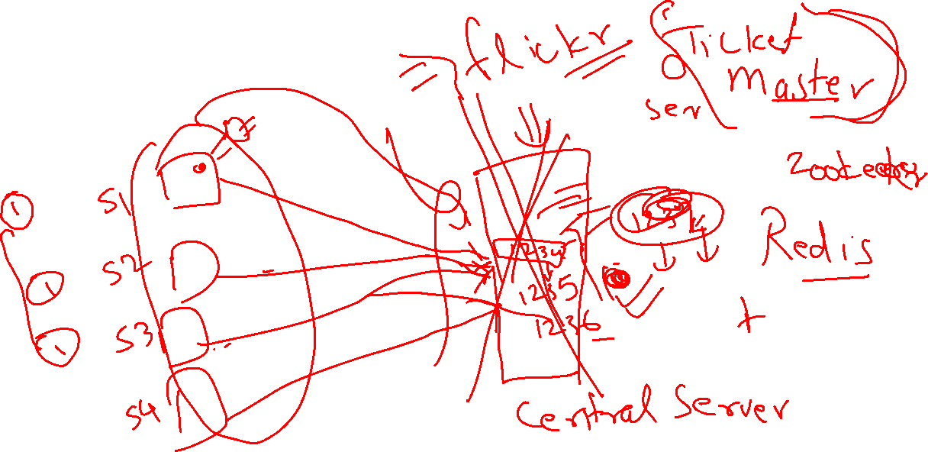
Central Server

Slide 22
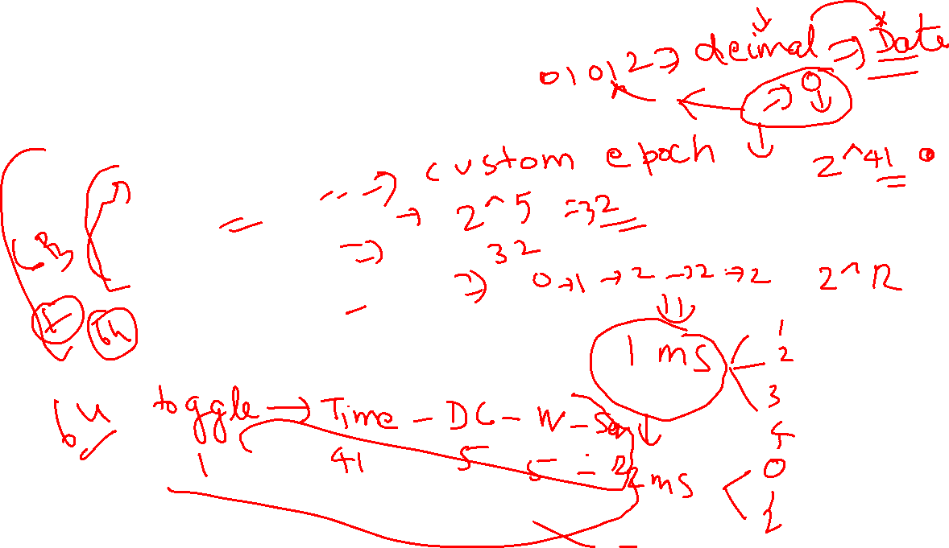
Snowflake
Structure of Snowflake ID
Timestamp – 41 bits
Datacenter ID – 5 bits
Worker ID – 5 bits
Sequence Number – 12 bits
Toggle Flag – 1 bit

Slide 23
Comparison of Options
Approach | Pros | Cons
Database Auto-Increment | Simple, consistent, transactional integrity | Scalability issues, performance bottleneck, single point of failure
UUID Version 7 | Globally unique, time-ordered, widely used | Larger size (128 bits), complexity
Central Server | Scalable, high throughput, flexible | Complexity, latency, single point of failure
Snowflake Algorithm | Scalable, ordered by date, high throughput, fits in 64-bit, distributed | Requires clock synchronization, slightly complex implementation

Slide 24
Java implementation for Unique id generator in distributed system
SYSTEM DESIGN
#codefarm
#SystemDesign
SOFTWARE ARCHITECTURE

Slide 25
Agenda
Project Structure
Implementing UUIDV7
Implementing Snowflake

